Slide 1


Planning and Preparation Sub: CL (Information Security Policies and Strategies)
Topic 5: Planning and Preparation
Introduction
Objectives of Policies, Standards, and Procedures

Slide 2
5.1 Introduction – Planning and Preparation
What is Planning in Information Security?
Planning
Planning means thinking in advance about possible cyber risks.
Preparation
Preparation means getting ready to stop or handle cyber attacks.
Protection
It helps an organization protect its important data.
Simple Meaning
"Be ready before a cyber attack happens."

Slide 3
Why Planning and Preparation is Important
Key Points
Cyber crimes are increasing daily.
Organizations store sensitive data.
Hackers target banks, companies, and government offices. Proper planning reduces damage.
It helps follow cyber laws like the IT Act 2000.

Slide 4
Main Activities in Planning
Important Steps
01 02
Identify possible risks. Create security policies.
03 04
Set security standards. Prepare procedures.
05 06
Train employees. Create incident response plan.

Slide 5
What is a Security Policy?
Definition
A security policy is a written document.
It explains rules for protecting information.
It tells employees what they should and should not do.
Example
Password policy.
Internet usage policy.
Email usage policy.

Slide 6





Objectives of Security Policy
Main Objectives
Protect company data.
Prevent unauthorized access.
Define employee responsibilities.
Maintain confidentiality.
Follow legal requirements.

Slide 7
Benefits of Security Policies
Advantages
Reduces risk of cyber attacks.
Builds customer trust.
Creates discipline among employees.
Protects company reputation.
Avoids legal penalties. Improves security awareness.

Slide 8
Losses Without Security Policies
Disadvantages
Data theft.
Legal problems.
Damage to company reputation.
Financial loss.
Loss of customers.
Business operations may stop.

Slide 9
What are Security Standards?
Definition
Standards are rules that define minimum security requirements.
They support security policies.
Example
Password must be at least 12 characters.
Use antivirus software.
Install software updates regularly.

Slide 10
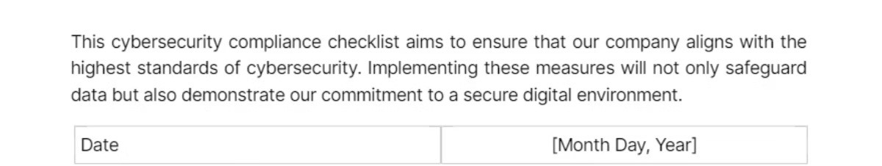
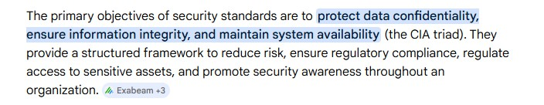



Objectives of Security Standards
Main Objectives
Maintain strong technical security.
Reduce system weaknesses.
Ensure all departments follow same rules.
Improve system safety.

Slide 11
What are Security Procedures?
Definition
Procedures are step-by-step instructions.
They explain how to follow policies and standards.
Example
Steps to report cyber attack.
Steps to change password. Backup process steps.
Objectives of Security Procedures
Main Objectives
Avoid confusion.
Ensure proper implementation. Improve response time.
Maintain consistency.

Slide 12

Real Life Cyber Incidents in India Case Study – Cosmos Bank Cyber Attack (2018)
What Happened?
In August 2018, hackers attacked the bank's ATM server.
Malware was installed in the system. Fake ATM transactions were approved.
Around ₹94 crore was stolen within two days.
Fraud withdrawals happened in India and other countries.
The SWIFT system was also misused for international transfers.
Reasons
Weak network security.
Lack of real-time monitoring. Poor security controls.
Inadequate incident response planning. Insufficient employee awareness.

Slide 13

Losses
Huge financial loss (₹94 crore).
Reputation damage. Loss of customer trust.
Regulatory investigation and pressure from RBI.

Slide 14
How They Secured the System (After the Attack)
01
02
03
Implemented strong Information Security Policies.
Introduced real-time transaction monitoring.
Applied multi-factor authentication.
04
05
06
Installed advanced firewall and anti-malware systems.
Conducted regular security audits.
Provided cybersecurity training to employees.
07
Developed proper incident response procedures.

Slide 15
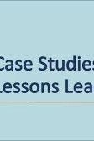
Lessons Learned
Important Lessons
Every organization must plan in advance.
Policies should be updated regularly. Employees need cybersecurity training. Strong monitoring system is required.
Vendor security must be checked.

Slide 16





Conclusion
Final Summary
Planning and Preparation is the first step in cybersecurity.
Security Policies give rules.
Security Standards give technical requirements.
Security Procedures give step-by-step instructions.
Without proper planning, organizations face heavy financial and reputation loss.

